Slide 1

GROCERY STORE MANAGEMENT
Presented by:
Shreya Joshi
Boddu Varshini
Kalakota Ramyasree

Slide 2
About Us
1. Name : Boddu Varshini
Background : Btech (Computer Science)
Linked in: https://www.linkedin.com/in/varshini-boddu-1b8913264?utm_source=share&utm_campaign=share_via&utm_content=profile&utm_medium=android_app
GitHub : https://github.com/Varshini-Boddu151
2. Name : Kalakota Ramyasree
Background : Btech (ECE)
Linked in: https://www.linkedin.com/public-profile/settings
GitHub : https://github.com/kalakotaramyasree
3. Name : Shreya Joshi
Background : Btech (Agricultural Engineering)
Linked in: https://www.linkedin.com/in/shreya-joshi-b84376350/
GitHub : https://github.com/S2023-maker

Slide 3
Agenda
Introduction
Objective of the Project
ER Diagram and schema explanation
About Tables
Key analysis questions (use cases)
SQL query results with screenshots or summaries
Final business insights and recommendations
Conclusion (Key finding overall)
Experience/Challenges working on SQL – Data Analysis Project.

Slide 4
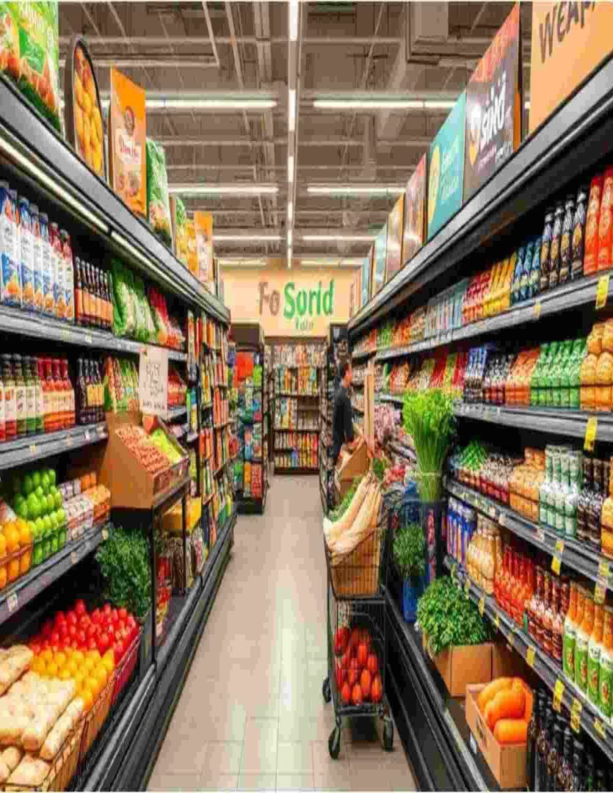
Introduction
The Grocery Store Management System focuses on efficiently managing key business operations such as product inventory, customer orders, suppliers, and employees.
Our project is designed to simulate a real-world retail environment, enabling structured data storage and retrieval through a relational database.
It helps track sales, revenue and stock levels, ensuring better decision-making and timely product availability.
The database structure integrates multiple entities—Products, Customers, Orders, Suppliers and Employees—to reflect realistic business interactions.
Using SQL queries, the project enables data extraction, transformation, and analysis to derive meaningful business insights.

Slide 5
Objective of the Project
Design and implement a well-structured relational database that accurately represents the
operations of a grocery store.
Retrieve, update, and manage data efficiently using SQL commands and queries.
Analyze business performance by identifying top customers, best-selling products and overall revenue trends.
Apply advanced SQL concepts such as joins, aggregations, and filtering to solve real-world data problems.
Develop data-driven insights to support better decision-making and improve store management efficiency.

Slide 6
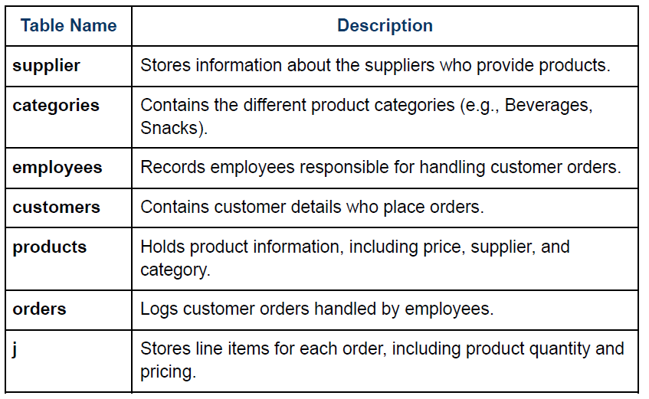
This project includes 7 interrelated tables:
Order Details

Slide 7
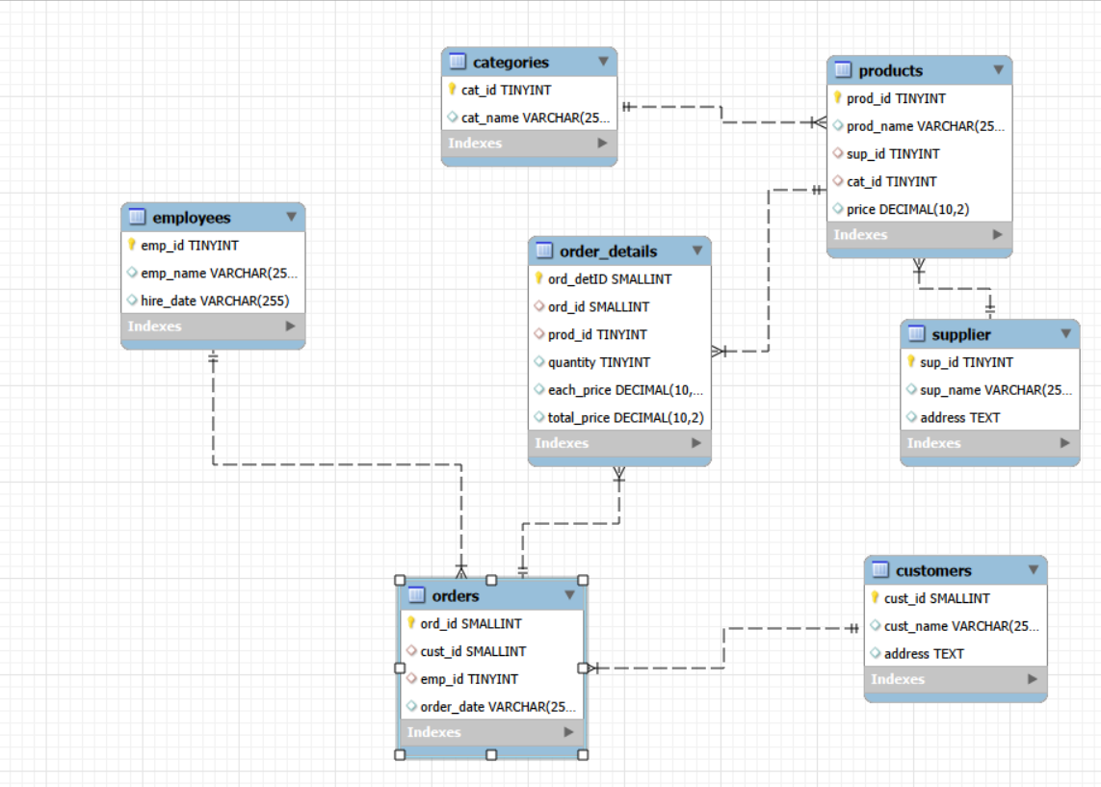
ER Diagram and schema explanation
● One-to-Many from supplier to products
● One-to-Many from categories to products
● One-to-Many from products to order_details
● One-to-Many from orders to order_details
● One-to-Many from customers to orders
● One-to-Many from employees to orders

Slide 8
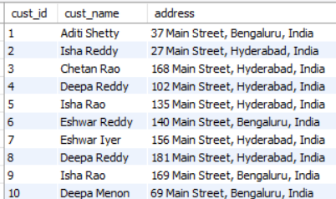
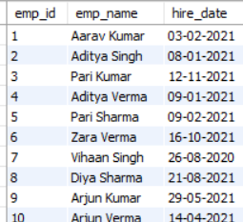
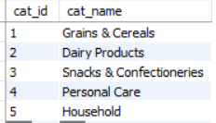
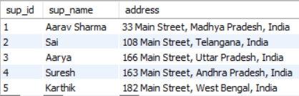
ABOUT TABLES
Customers Table
Employees Table
Catergories Table
Supplier Table

Slide 9
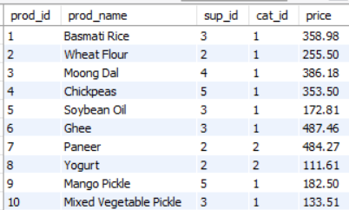
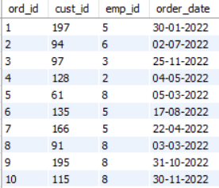
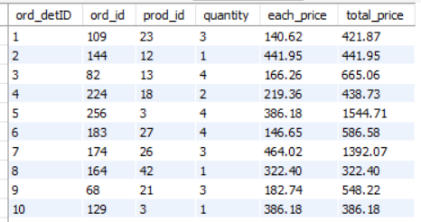
Products Table
Orders Table
Order details Table

Slide 10
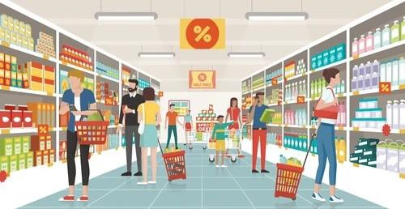


Customer Insights: Gain an understanding of customer engagement and purchasing behavior. 1. How many unique customers have placed orders?
Query
Output
Key Insights:
156 out of 200 customers have placed orders, meaning 44 customers (22%) are inactive

Slide 11

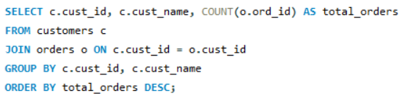
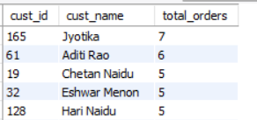
2. Which customers have placed the highest number of orders?
Query
Output
Key Insights:
A small group of repeat customers dominates order frequency
Jyotika placed highest number of orders

Slide 12
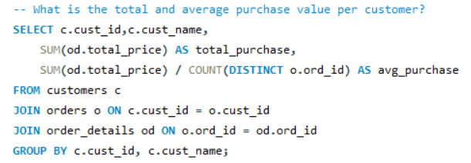
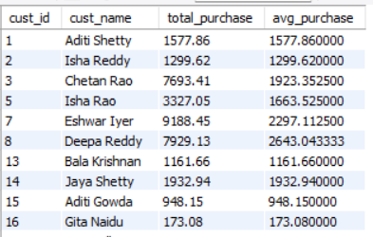
3. What is the total and average purchase value per customer?
Query Output

Slide 13
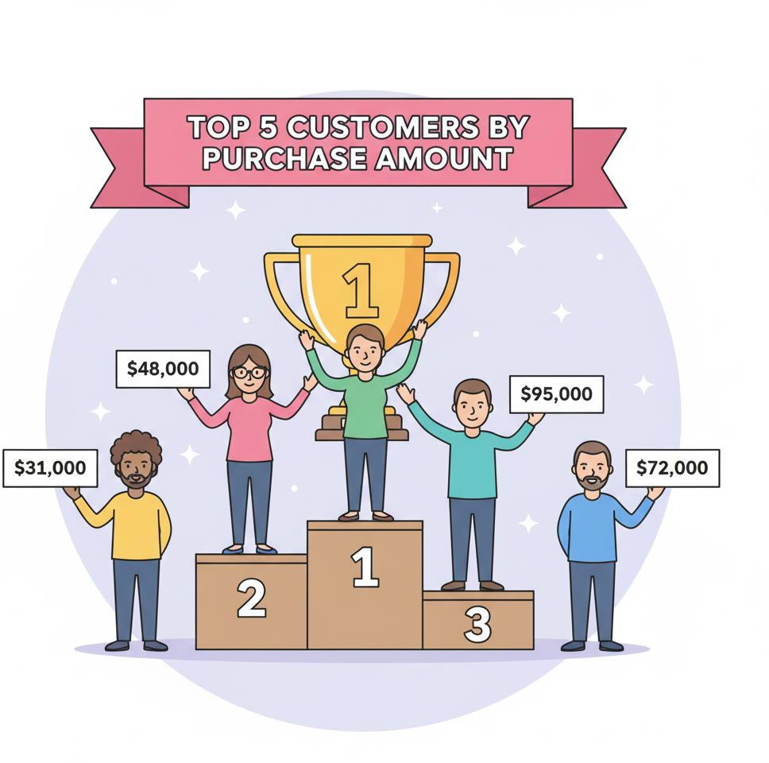
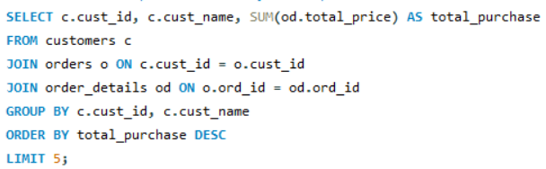
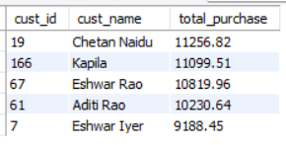
4. Who are the top 5 customers by total purchase amount?
Query
Output
Key Insights:
The top 5 customers fall in the ₹9,000–₹11,500 sales range

Slide 14
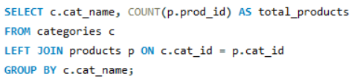
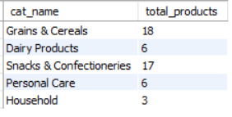
Product Performance Evaluated how well products are performing in terms of sales and revenue. 1. How many products exist in each category?
Query
Output
Key Insights:
Grains & Cereals and Snacks & Confectioneries have the highest product count, reflecting strong consumer demand in these everyday staple categories.
Household has only 3 products.

Slide 15
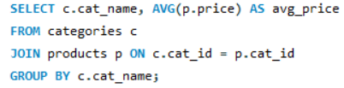

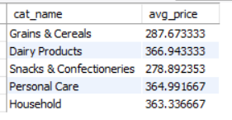
2. What is the average price of products by category?
Query
Output

Slide 16

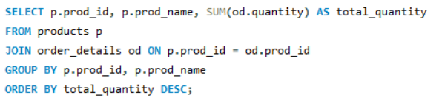
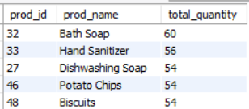
3. Which products have the highest total sales volume (by quantity)?
Query
Output
Key Insights:
Bath soap, hand sanitizer, dishwashing soap, potato chips, and biscuits are top movers — these must maintain robust stock levels to avoid stockouts.

Slide 17
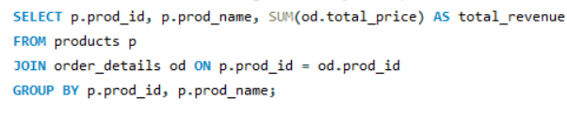

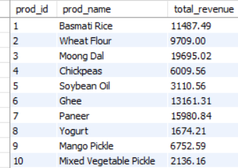
4. What is the total revenue generated by each product?
Query
Output

Slide 18
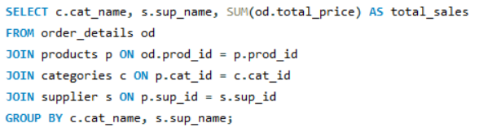
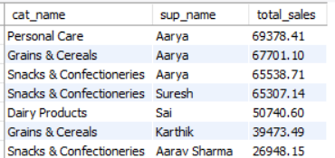
5. How do product sales vary by category and supplier?
Query
Output
Key Insights:
Personal Care – Aarya has the highest sales (~69K), so it is the best-performing segment.
Grains & Cereals and Snacks & Confectioneries show up many times with high sales, which means these categories are in high demand.

Slide 19
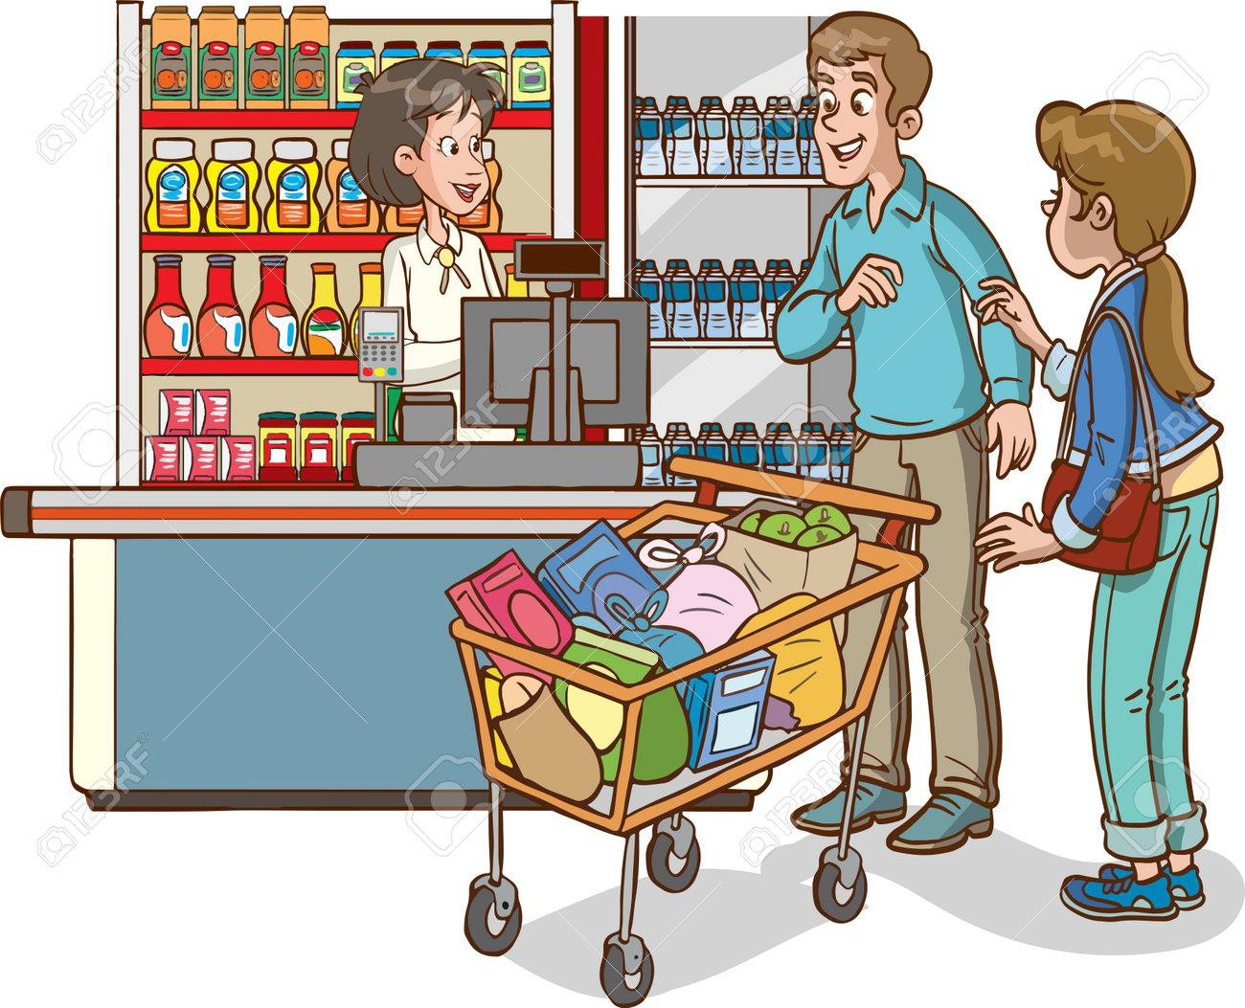


Sales and Order Trends: Analyze business performance through orders and revenue over time. 1. How many orders have been placed in total?
Query
Output
Key Insights:
With 300 orders from 200 customers, the average is 1.5 orders per customer.

Slide 20


2. What is the average value per order?
Query
Output
Key Insights:
On average, each customer order is worth about ₹2154.
Customers are spending around ₹2154 per order.

Slide 21
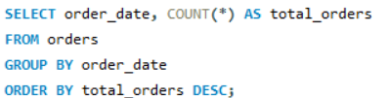
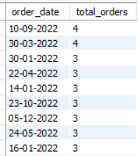
3. On which dates were the most orders placed?
Query Output
Key Insights:
10-09-2022 and 30-03-2022 → Highest orders (4 orders each).
These are peak demand days.

Slide 22
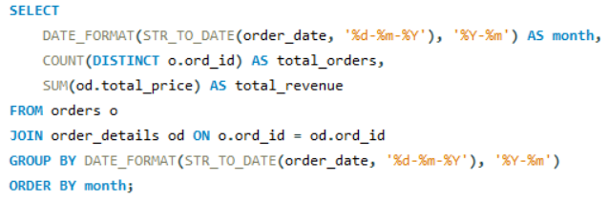
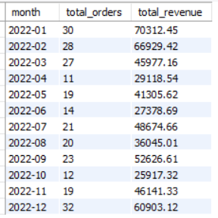
4.What are the monthly trends in order volume and revenue?
Query Output
Key Insights:
Sales are highest in January and December, indicating strong seasonal demand.
A noticeable dip in sales is seen between April and June.
Months with more orders usually have higher revenue → direct relationship

Slide 23
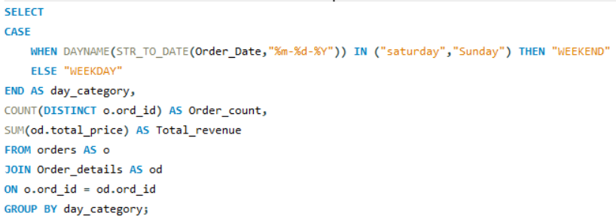

5. How do order patterns vary across weekdays and weekends?
Query
Output
Key Insights:
Weekdays → more frequent, smaller purchases
Weekends → fewer but higher-value purchases

Slide 24



Supplier Contribution: Identifying the most active and profitable suppliers. 1. How many suppliers are there in the database?
Query
Output

Slide 25
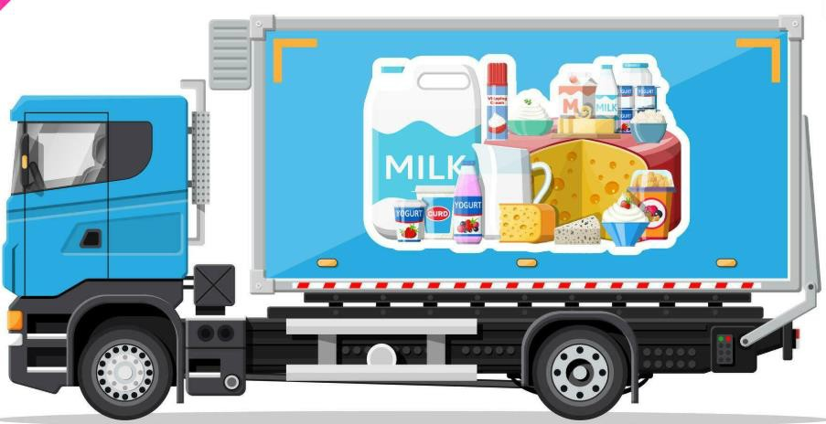
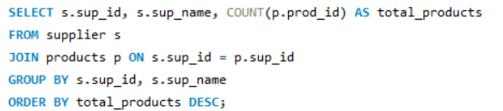
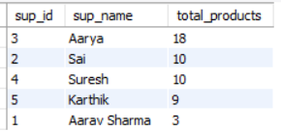
2. Which supplier provides the most products?
Query
Output
Key Insights:
Aarya supplies 18 products the highest among all suppliers and also delivers the highest sales.

Slide 26
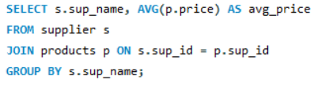

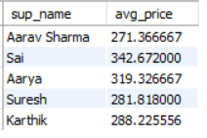
3. What is the average price of products from each supplier?
Query
Output
Key Insights:
It helps understand which supplier sells expensive vs cheaper products.
Sai positioned as premium and Aarav Sharma as budget-friendly, helping target different customer segments.

Slide 27
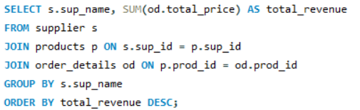
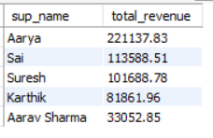
4. Which suppliers contribute the most to total product sales (by revenue)?
Query
Output
Key Insights:
Aarya is the top supplier with ₹221,137.83, contributing the highest revenue by a large margin.
Arava Sharma contributes minimally in both product count and sales

Slide 28
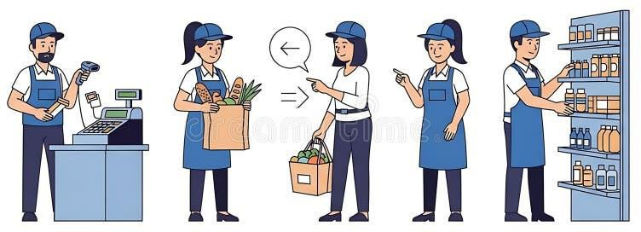


Employee Performance: Assessing how employees are handling and influencing sales. 1. How many employees have processed orders?
Query
Output

Slide 29
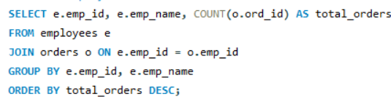
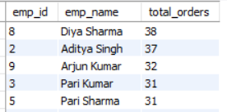
2. Which employees have handled the most orders?
Query
Output
Key Insights:
Diya Sharma handled the most orders (38), followed by Arjun Kumar.

Slide 30
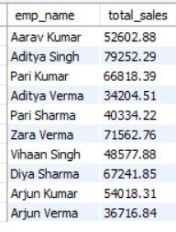
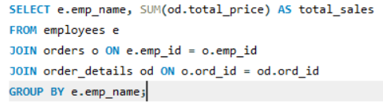
3. What is the total sales value processed by each employee?
Query Output
Key Insights:
Aditya Singh, Zara Verma, and Diya Sharma lead in total sales value.

Slide 31
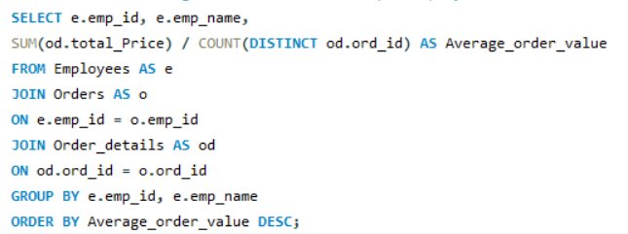
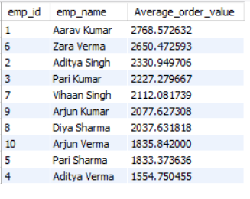
4. What is the average order value handled per employee?
Query
Output
Key Insights:
Top employees like Aarav Kumar and Zara Verma handle significantly higher average order values, indicating stronger sales efficiency or higher-value deals.

Slide 32

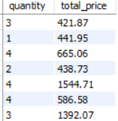
Order Details: Explore item-level sales patterns and pricing behavior 1. What is the relationship between quantity ordered and total price?
Query
Output
Key Insights:
Total price generally increases with quantity, showing a positive relationship.
But some lower quantities still have high prices, indicating differences in item pricing or premium products.

Slide 33
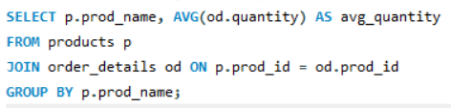

2. What is the average quantity ordered per product?
Query
Output

Slide 34


3. How does the unit price vary across products and orders?
Query
Output
Key Insights:
Prices are consistent for each product (avg = min = max), indicating fixed pricing with no variation or discounts.
Low-priced essentials (like salt, yogurt) drive volume but not high value.
High-priced items (like ghee, paneer, spices) contribute more revenue per sale

Slide 35
Key Insights and Recommendations
Customers
According to our dataset store having 200 customers and they placed 300 orders and from those orders there are 156 unique customers have placed orders.
From the unique customers 80% of the customers are purchasing the multiple quantities of products(more than 1 quantity).
Top 5 customers generating more revenue by purchasing in higher amount. The sales range is (11500-9000)
Focus on increasing repeat purchases by introducing bundle offers or discounts

Slide 36
Key Insights and Recommendations
Products
Products having 5 categories in those Grains and Cereals , Snacks and Confectioneries has more
product count and Household category having only 3 products.
In products particularly Bath soap, Hand sanitizer, Dishwashing soaps, potato chips, biscuits
having high sales by quantity, So we should maintain sufficient stock of these products.
And some products are having less sales by quantity so we can cutdown the stock from suppliers
Ex. Ghee, Conditioner

Slide 37
Key Insights and Recommendations
Suppliers
Aarya providing 18 products which is highest among all the suppliers. Not only the more products the sales of each product supplied by Aarya giving highest sales. So we will continue with Aarya.
In Dairy Products supplier “Sai” is highest with total sales are 50740.
Arava Sharma providing less products and the sales are also less. So we need to stop supply from Arava Sharma.

Slide 38
Key Insights and Recommendations
Employees
Among all employees Diya Sharma handled more orders(38)
Next is Arjun Kumar ordered more orders
Aditya Singh, Zara Verma, Diya Sharma handled highest total sales, so these employees also done their job well.

Slide 39
Key Insights and Recommendations
Orders
Soyabean oil, yogurt, mixed vegetables, white bread these items we should reduce particularly because of less life span and less orders.
We didn’t put any discount on products. So we didn’t observed unit price variation on same products
We need to try discounts on particular products in specific time and observe the trends and at
least for the items which are having less sales, so that it can improve our sales.

Slide 40
Conclusion
Designed a well-structured relational database using multiple tables
Established proper relationships between tables for efficient data handling
Performed analysis using advanced SQL queries (joins, aggregations, etc.)
Evaluated overall store performance and sales behavior
Provided recommendations to improve store management
Successfully achieved all project objectives
Insights derived can help the grocery store increase sales and efficiency

Slide 41
Challenges Faced
Major challenging to extract months, years, or trends from date data if it’s stored as text (VARCHAR)
instead of a proper DATE format.
Our project data is spread across multiple tables, combining it to find totals, averages, or counts can get
complicated, especially if the joins aren’t done correctly.
It can be challenging to figure out how different tables are connected and which type of join (INNER,
LEFT, RIGHT etc.) to use to get accurate results.
And while writing insights also many insights derived only when we combining different outcomes from different queries. Some times it felt challenging while comparing different queries outcomes at same time and also it felt interesting.

Slide 42


THANK
YOU

